Slide 1

Research Computing Services
Northwestern Postdocs Association
SPIE
Introduction to Python
for non-programmers
http://bit.ly/2tbm12e
Janna Nugent: janna.nugent@northwestern.edu
Alper Kinaci: akinaci@northwestern.edu
Christina Maimone: christina.maimone@northwestern.edu

Slide 2
https://github.com/nuitrcs/pythonworkshops/Part_1
Introduction to Python
for non-programmers
or
http://bit.ly/2tbm12e

Slide 3
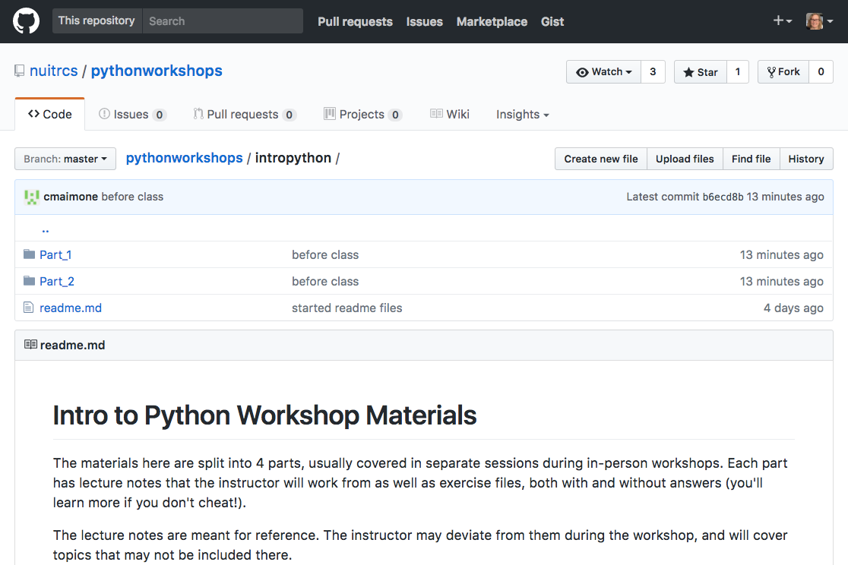
https://github.com/nuitrcs/pythonworkshops/tree/master/intropython

Slide 4
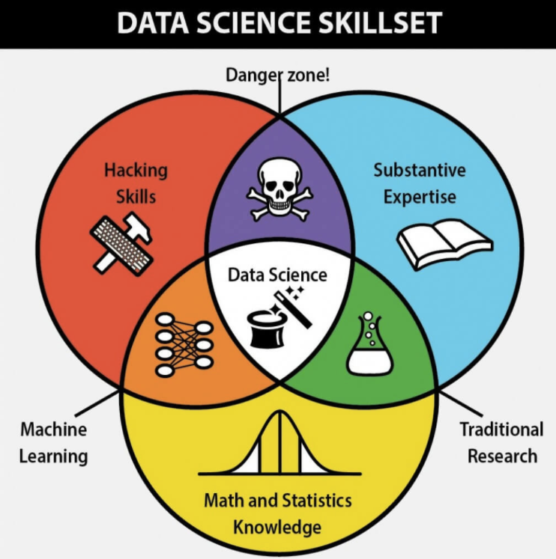

Slide 5
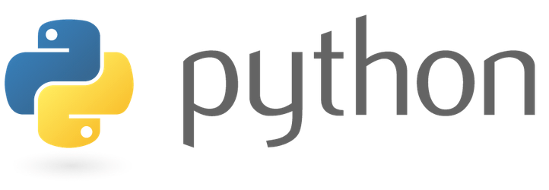

Which tool to use depends on what you need to do with it

Slide 6
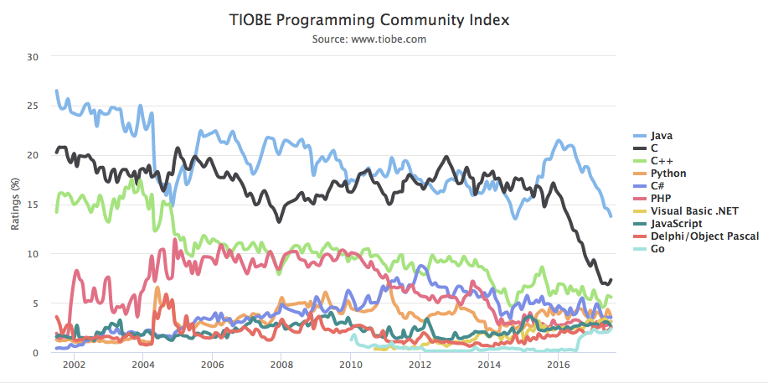
Top 10 Programming languages as of 6/17
Python
“The ratings are based on the number of skilled engineers world-wide, courses and third party vendors. Popular search engines such as Google, Bing, Yahoo!, Wikipedia, Amazon, YouTube and Baidu are used to calculate the ratings.”

Slide 7

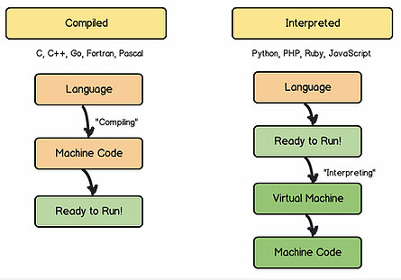

Programming languages:
Compiled vs. Interpreted
Python
if (1+1) == 2
{math = True};
if (1+1) == 2
{math = True};
010101001011
100001110101
001100111110
> python program.py
010101001011
100001110101
001100111110
> program.c
Faster,
more control
Slower,
portable
http://www.hackersclub.io/single-post/2016/04/06/Scripting-vs-Coding-vs-Programming

Slide 8
Why Python for Data Science?
Easy to learn - shorter learning curve than most other languages (C, Java, R)
Lots of ways to code: Jupyter notebooks, PyCharm, scripting, interpreter
Easy to load data: .txt|.csv|.json etc.
Multiple ways to manipulate data: Python can load the data into an Array/Dataframe using either Numpy or Pandas
Large community, available to answer questions, provide examples and learning materials (stackoverflow.com)
Free & open source

Slide 9
Many Data Science libraries are available for Python, and they are easy to install (using pip):
DataFrame- Pandas
Machine Learning- scikitlearn
Statistics- Scipy
Arrays- Numpy
Plots- matplotlib
Science- anaconda distribution
DataScrapping- BeautifulSoup
FetchUrldetails- urllib

Slide 10
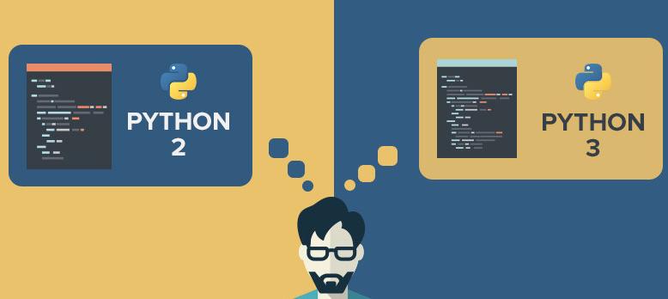
What version of Python?
Forked in 2008
2.7 vs. 3.6

Slide 11

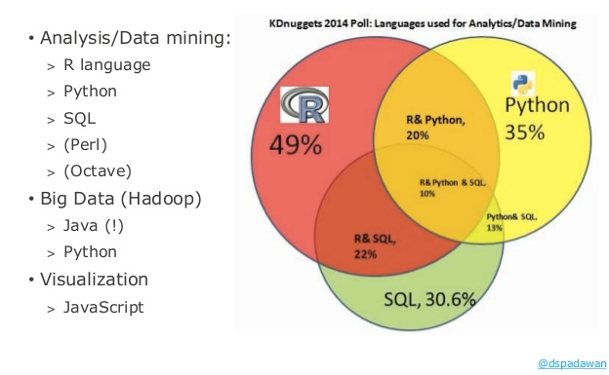
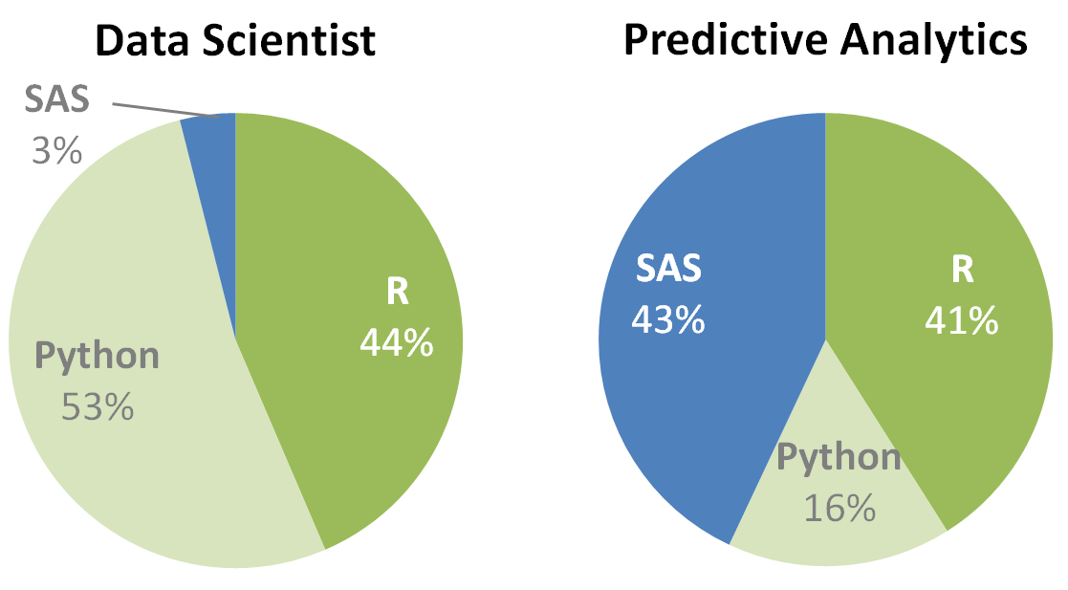
What about R and SAS?
KDnuggets, 2016

Slide 12
Top 10 Programming languages as of 6/17
Python
“The ratings are based on the number of skilled engineers world-wide, courses and third party vendors. Popular search engines such as Google, Bing, Yahoo!, Wikipedia, Amazon, YouTube and Baidu are used to calculate the ratings.”

Slide 13
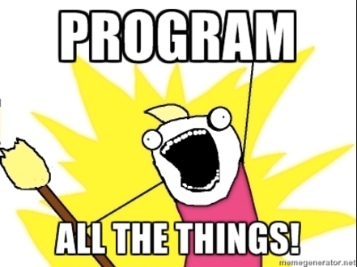
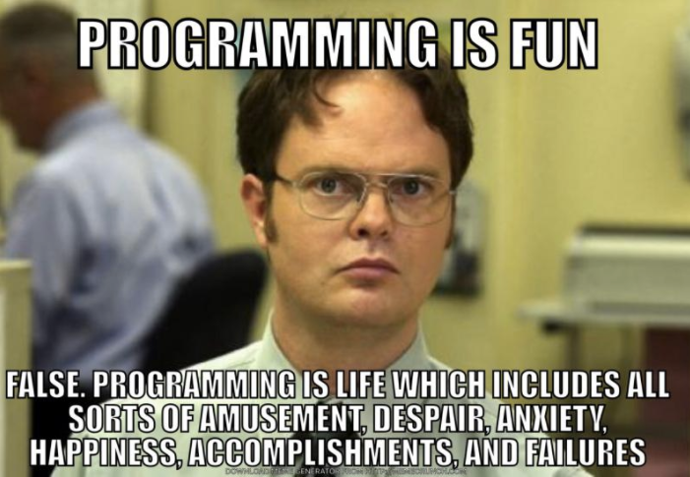
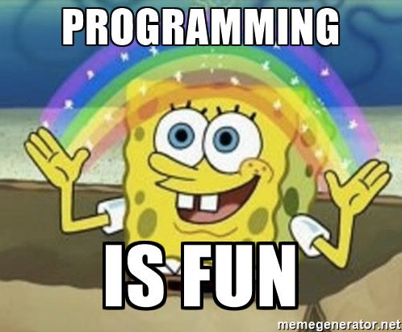
Let’s get started!

Slide 14
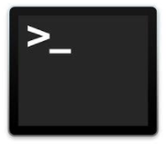
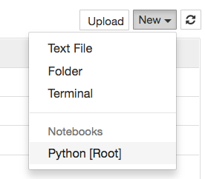

Let’s get started: Jupyter (mac)
Open Terminal
type “jupyter notebook”
New -> Python [Root]
quit: Use Control-C to stop this server and shut down all kernels (twice to skip confirmation).

Slide 15
Let’s get started: Jupyter (PC)
Open: Installed as a program - click on the icon
New -> Python [Root]

Slide 16
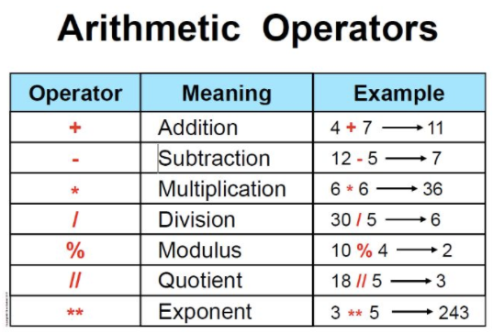
Math

Slide 17
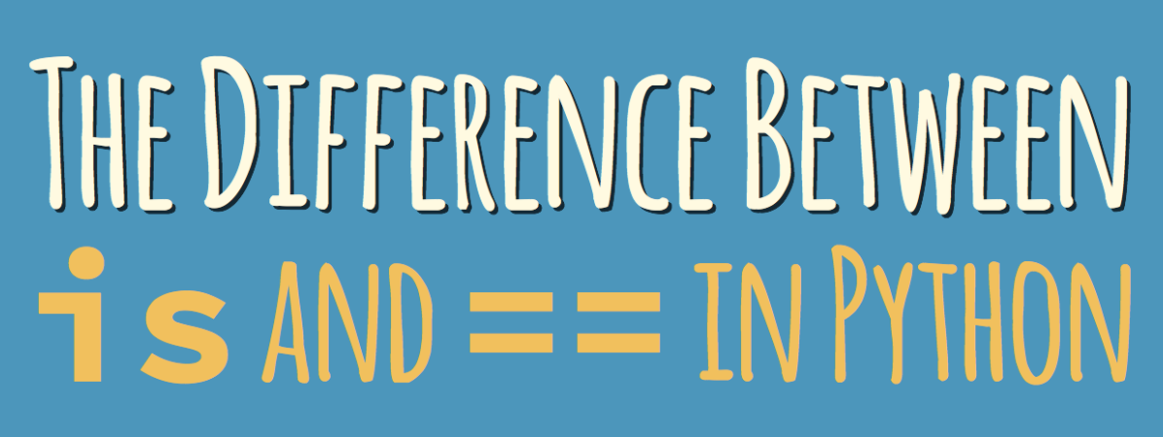
Math
“=“ reads in your head as “is”
“==“ reads in your head as “is actually equal to”

Slide 18
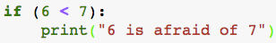
if statement
“:“ reads in your head as “do”
Is this true?
exactly 4 spaces indented

Slide 19
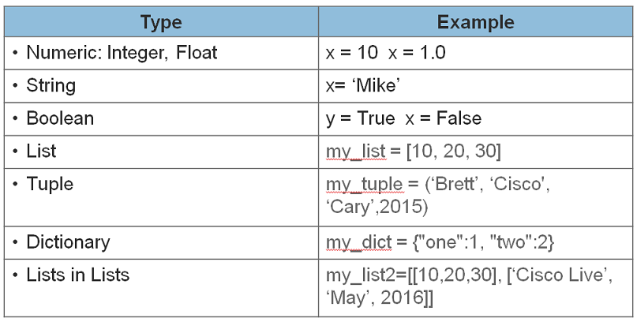
Types
https://learninglabs.cisco.com/posts/files/00-prep-04-python-primer2/assets/images/python-datatypes2.png

Slide 20
Types
integer, also called an “int” - no decimal point
example: 10
float, also called floating point number –
has a decimal point that can appear anywhere in
the number. example: 10.0, 10.6
.123456789, 1234.56789,12345678.9
“floating”
https://learninglabs.cisco.com/posts/files/00-prep-04-python-primer2/assets/images/python-datatypes2.png

Slide 21
Floating Point Math
“Squeezing infinitely many real numbers into a finite number of bits requires an approximate representation. Although there are infinitely many integers, in most programs the result of integer computations can be stored in 32 bits. In contrast, given any fixed number of bits, most calculations with real numbers will produce quantities that cannot be exactly represented using that many bits. Therefore the result of a floating-point calculation must often be rounded in order to fit back into its finite representation. This rounding error is the characteristic feature of floating-point computation.”
- What Every Computer Scientist Should Know About Floating-Point Arithmetic, by David Goldberg

Slide 22
Floating Point Math
“The most common situation is illustrated by the decimal number 0.1. Although it has a finite decimal representation, in binary it has an infinite repeating representation. The number 0.1 lies strictly between two floating-point numbers and is exactly representable by neither of them.”
- What Every Computer Scientist Should Know About Floating-Point Arithmetic, by David Goldberg
http://floating-point-gui.de/basic/

Slide 23

Strings

Slide 24

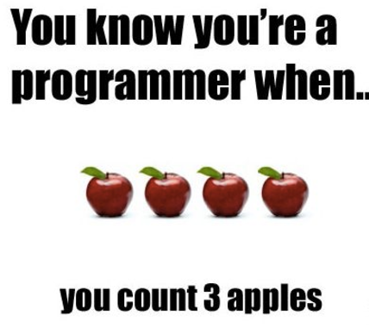
Strings
1 2 3 4 5 6 7 8 9 10 11 12 13 14 15 16 17
0 1 2 3 4 5 6 7 8 9 10 11 12 13 14 15 16
T h i s i s a s t r i n g !
Individual characters

Slide 25
Lists
0 1 2 3 4
0 1 2 3 4 5 6 7 8 9 10 11 12 13 14 15 16
“Jan”
“Feb”
“Mar”
“Apr”
“May”
T h i s i s a s t r i n g !
Individual characters
Individual objects
my_string[3]
my_list[3]

Slide 26
Solving Problems
“The most common mistake I see when conducting interviews or watching someone try to solve a programming problem is they try to start writing code as soon as possible.
You must resist this urge.
You really want to make sure you take enough time to understand the problem completely before attempting to solve it.”
-Matt Sonmez
https://simpleprogrammer.com/2011/01/08/solving-problems-breaking-it-down/

